Slide 1
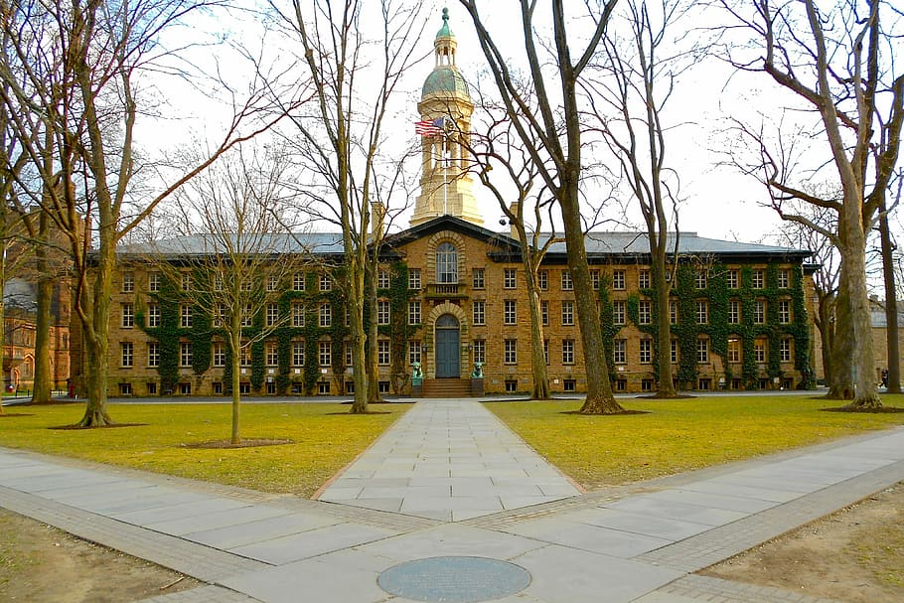
COLLEGE FEE MANAGEMENT
system

Slide 2

INTRODUCTION
1.OBJECTIVE
2.C,DSA IMPORTANCE
3.ALGOTIYHUM
4.LESSON LEARNT
5.OUTPUT IMAGES

Slide 3

OBJECTIVE

Slide 4
To develop a simple console-based College Fee Payment Tracker in C that allows users to record student fee payments, generate payment receipts, and view all recorded transactions, using file handling to ensure data persistence.
OBJECTIVE

Slide 5
3
1
4
2
FOUR
Both help in coding interviews
They make programs faster and smarter
DSA improves problem-solving
C builds strong basics
points

Slide 6
3
1
4
2
FOUR
Both help in coding interviews
They make programs faster and smarter
DSA improves problem-solving
C builds strong basics
points

Slide 7
3
4
1
2
C builds strong basics
DSA improves problem-solving
Both help in coding interviews
They make programs faster and smarter

Slide 8

ALGORITHUM
Start Program
Show Menu:
Record Payment
Print Receipt
Show Records
Exit
Get User Choice
Process Based on Choice:
1. Record Payment:
Input student name and amount
Get current time
Save data to records.txt
2. Print Receipt:
Input student name and amount
Get current time
Display formatted receipt
3. Show Records:
Read and display contents of records.txt
4. Exit:
Terminate program
Invalid Choice:
Show error, re-display menu
Repeat until user chooses Exit.

Slide 9

Lessons Learned:
How to use files in C:
Learned how to open, write, read, and close files.
Learned how to save data without losing old records.
How to get the current date and time:
Learned how to add date and time to the payment records.
How to take user input properly:
Learned how to take full names (with spaces) from the user.
How to create a menu:
Learned to make a menu with choices using loops and switch-case.
How to handle errors:
Learned to check if a file opens successfully or not.
How to format output nicely:
Learned how to print numbers with two decimal places for amounts.
Why saving data is important:
Understood that using files keeps the data safe even after the program closes.

Slide 10

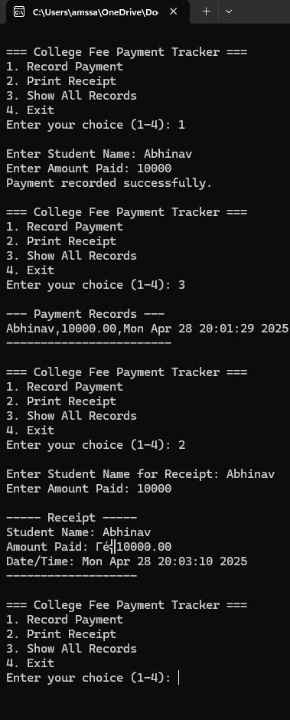
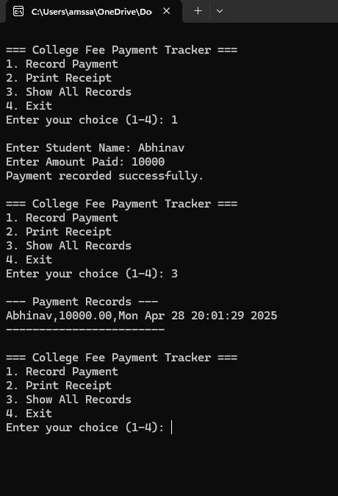
OUTPUT
When Recording Payment:
Asks for student's name and amount paid.
Saves the information (name, amount, date/time) into a file called records.txt
Displays a receipt
Reads and displays all the records stored in records.txt.

Slide 11
OUTPUT
THANK YOU
When Recording Payment:
Asks for student's name and amount paid.
Saves the information (name, amount, date/time) into a file called records.txt
Displays a receipt
Reads and displays all the records stored in records.txt.

